Slide 1
AI, DEI&B, IOT, and the Future of HR
Sept. 23, 2022
Tom McKeown, Product Owner
Geoff Webb, VP of Product and Solution Marketing & Strategy

Slide 2

The Role of AI and IoT in a more Human Workplace
The questions:
How can technologies like A.I. and HCM platforms, connected to IoT and mobile devices, make the workplace more human?
How can businesses of every type get value from them?

Slide 3

The Challenges are Consistent
HR Teams need help:
Businesses need to find, hire and keep the best employees.
They also need to reduce the workload of HR processes like payroll and reporting.
And they need to make meeting compliance and other legal requirements much much easier.
Notes:
48% of HR leaders say they expect recruiting to be more difficult in 2022. (isolved’s 2022 Transforming Employee Experience Report)
22% of HR leaders say competitors with larger budgets is the top threat facing talent acquisition. (isolved’s 2022 Transforming Employee Experience Report)
25% of HR leaders say their most valuable recruiting tool is employee referrals. 49% are offering cash referral bonuses as incentives. (isolved’s 2022 Transforming Employee Experience Report)
HR leaders say employee experience is their company’s biggest opportunity to improve HR this year

Slide 4
Retention is Challenging
HR leaders say retaining talent was more
difficult in 2021.
(isolved’s 2022 Transforming Employee Experience Report)
  Survey of 500 HR leaders

Slide 5
Delivering a good Employee Experience
It starts from day 1
A poor enrollment experience would make 64% of employees consider looking for another job.
And it carries on, through every interaction

Slide 6
It’s all about Employee Experience
In fact, 83% HR leaders say their organization is making EX a priority this year
  Survey of 500 HR leaders

Slide 7

The right way to do this
Successful HR teams are becoming:
More agile – because things are changing fast
More data-driven – because your business needs decisions taken on data, not gut feeling
More focused on employee-experienced – because losing your best employees is something no business can afford

Slide 8

The Changing Shape of HR
How can HR teams in every business, of every size, build a diverse workforce, that feels connected and empowered?
How can technology help them do all that before they become overwhelmed?
Notes:
48% of chief human resources officers (CHROs) say their current HR technology solutions hinder, rather than improve, employee experience
(Gartner, 2021: Top Strategic Technology Trends for HR Leaders)

Slide 9

Is A.I the answer?

Slide 10

What can the Role of Tech be?
“If you don’t know where you’re going, you might end up somewhere else.”
Yogi Berra

Slide 11
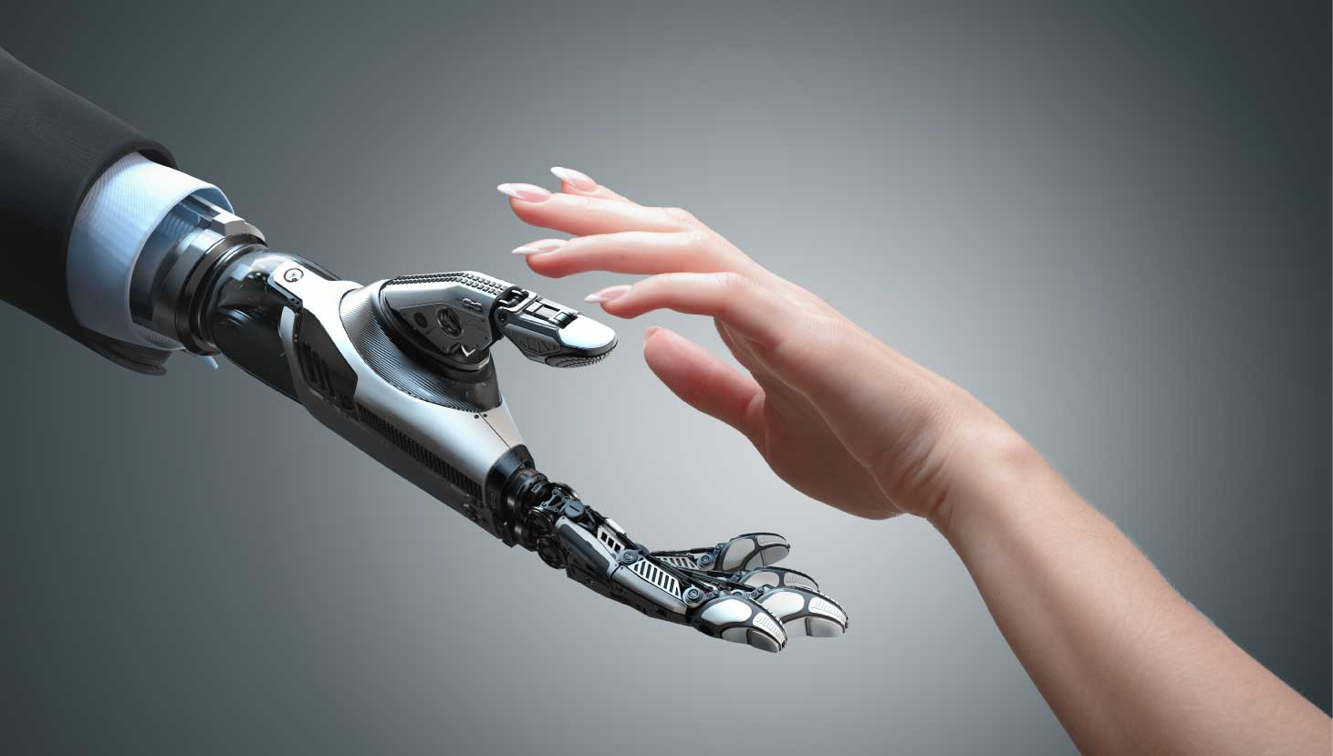
How Does Technology Help?
“Show me the trends I may be missing”
A.I.
“Give me easier access to things I need”
“Give me access anywhere”
IoT/Mobile
“Make access simple”

Slide 12

Technology can free us to be human

Slide 13

Some Practical Examples
Onboarding and Benefits administration – AI chatbots make it easy for employees to self-serve
Hiring – AI-based analytics can identify trends in retention based on where you are hiring
Accessibility – AI can provide multiple ways to interact with an HR system
DEI&B – AI based analytics can identify hiring and employment trends early
Availability– IoT and Mobile make access to the all HR functions (time-off, reporting, management etc.) available anywhere, any time
Retention – AI analytics identify retention drivers for key employees

Slide 14

Let’s paint a picture
For Employees
They want a better experience – to feel connected, empowered, to take control, and be valued.
For HR and the business:
They need to get through the day without fighting fires. They want to improve retention and reduce the workload. And they need to make good decisions, faster.
For the companies they rely on:
They need technology that delivers a reliable, secure service that enables them to deliver value at every level – operational and strategic

Slide 15
Let’s see this in action

Slide 16
The Real Benefits
More diverse, more human workplace
Simplicity and focus for HR leaders
More agility for the business
Accessibility, anywhere, anytime
A HR system that works, reliably, securely, and is delivered as a supporting fabric to business success

Slide 17
Summary and Key Takeaways
The future of the workplace is one that must attract, engage, develop and retain the right employees.
HR Professionals need:
Technology to unshackle HR teams from the day-to-day and let them focus on building the right employee experience by becoming more agile and more data-driven.
Look for:
Technology that uses approaches like AI and mobility in all its forms, not as a cool add-on, but as a foundation to delivering HCM that is scalable, secure, and meets the needs of the business.

Slide 18


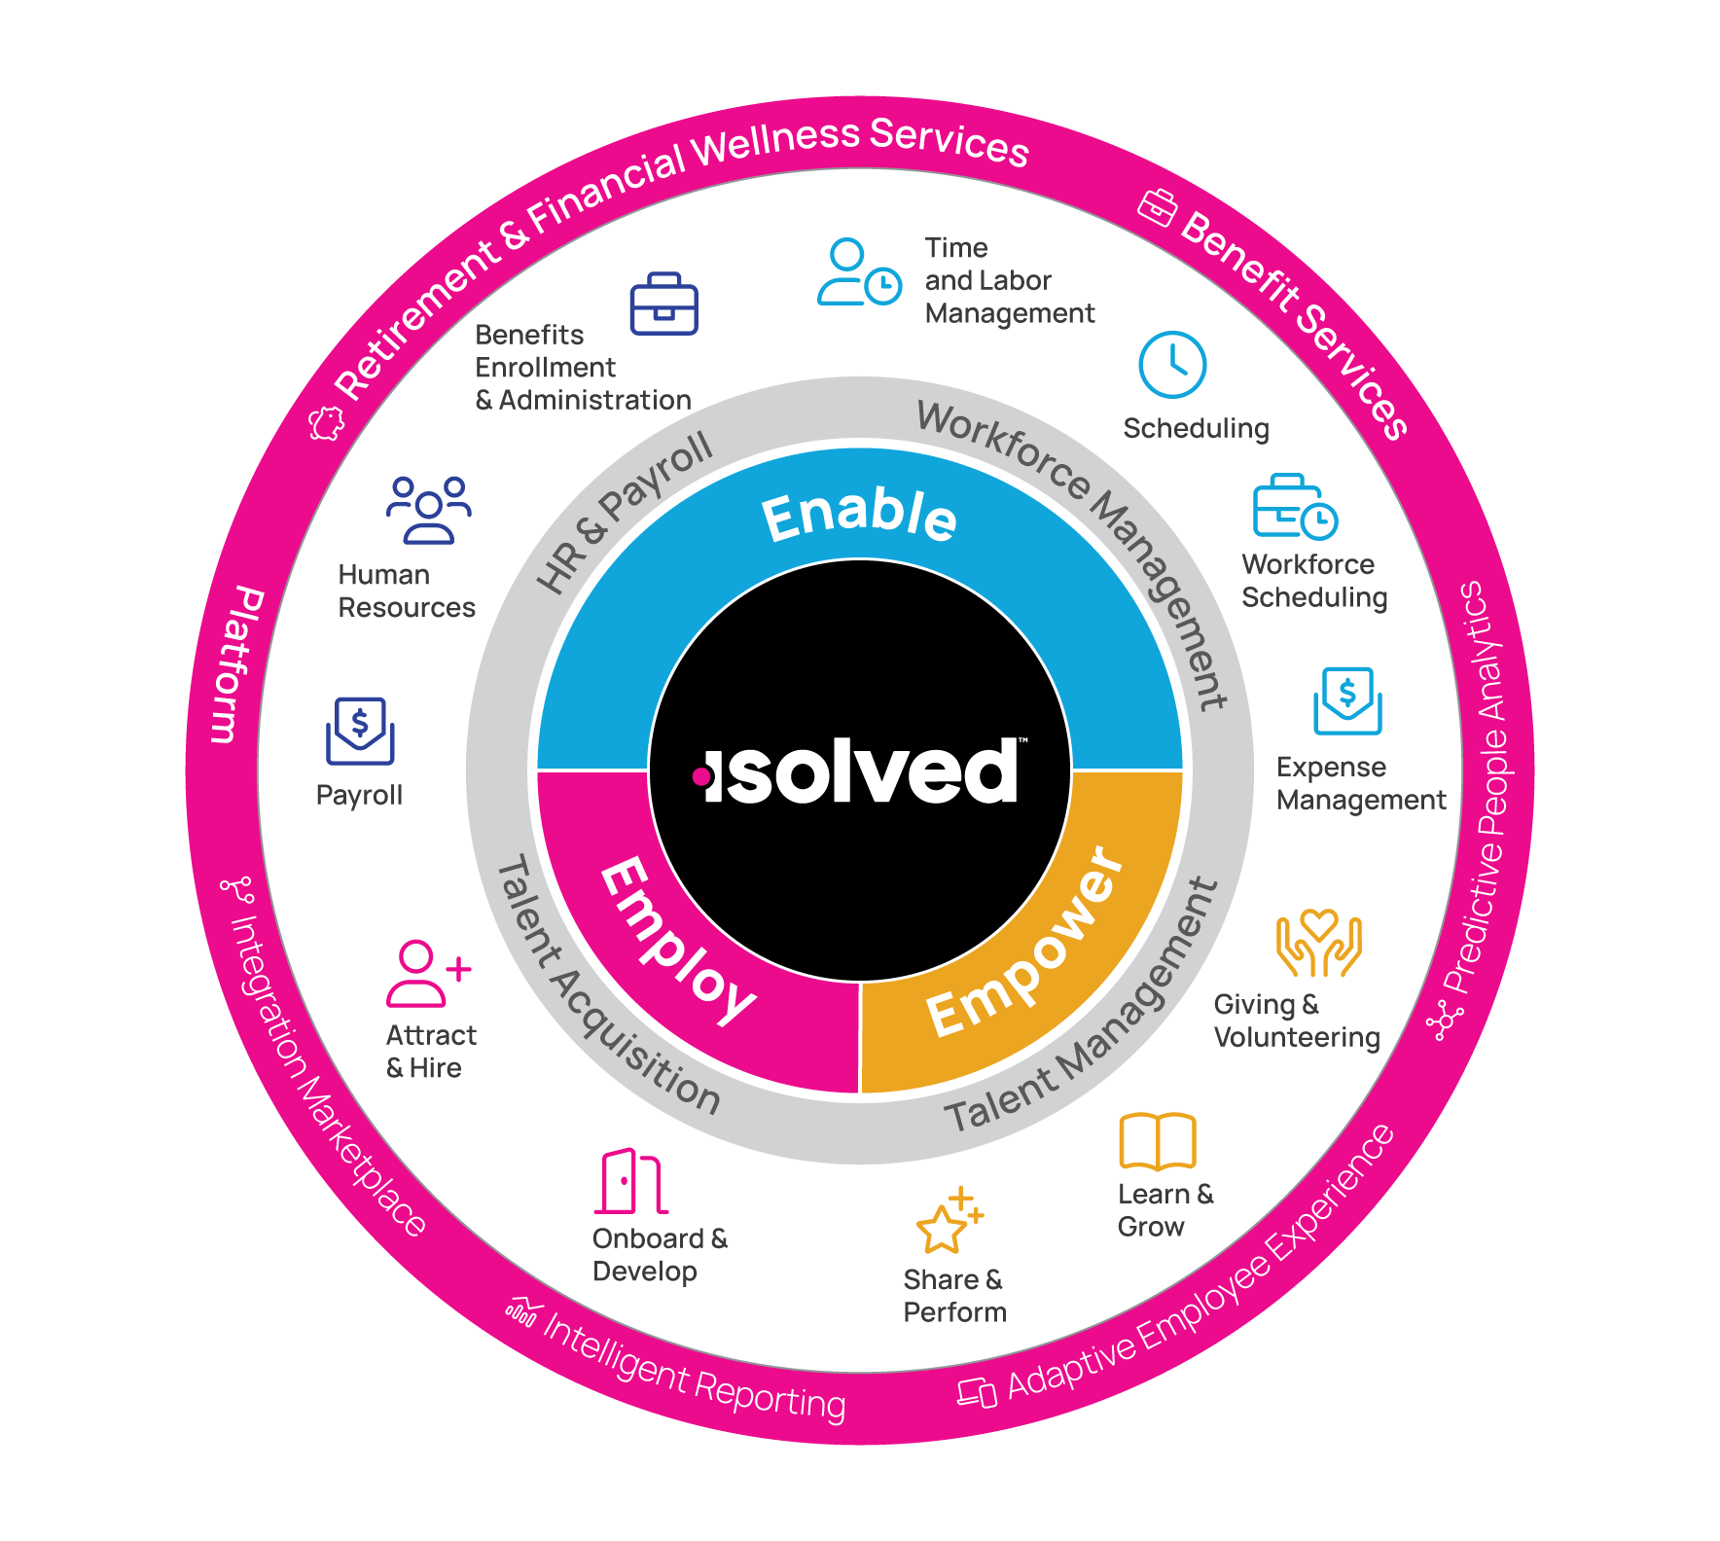
Thank you!
We hope this has been interesting and useful.
For more information on how AI-enabled HCM technology can help you and your customers please contact Melissa Christensen
mchristensen@isolvedhcm.com

